Slide 1

Music Industry Analysis
By:
Haripriya Vemulapati
Debolina Sasmal
Grace Tan
Jack Qu

Slide 2
TABLE OF CONTENTS
Introduction
Business Problem
Exploratory Data Analysis (EDA)
Clustering
Classification Modeling
Recommendation System
Managerial Conclusions & Future Scope

Slide 3
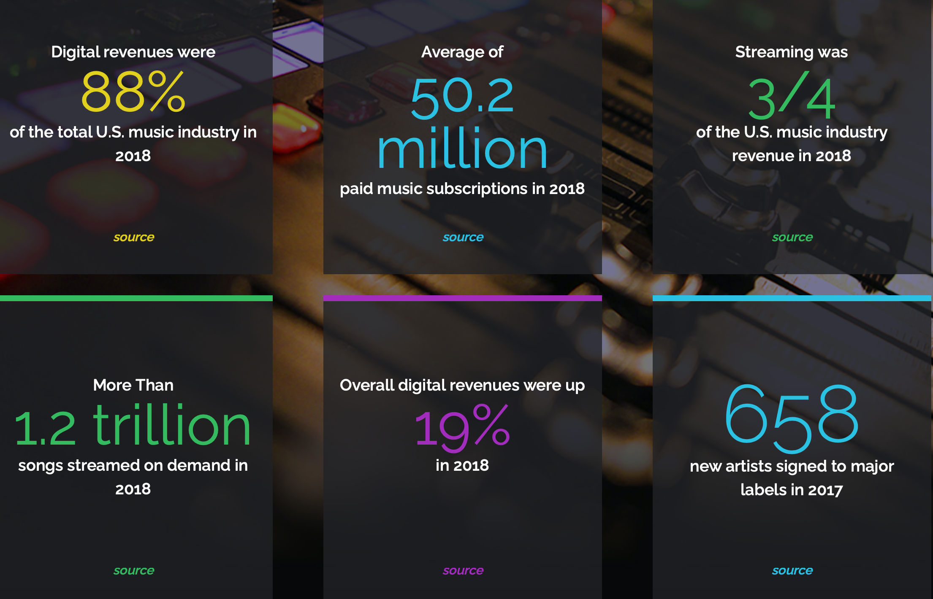
Music Industry has undergone massive transformation over the past two decades. Several events have marked the key changes in history such as shift in listening platforms from physical(CD’s, Cassettes) to digital and streaming platforms. The digitization of music had presented challenges such as piracy and illegal sharing on peer-to-peer sharing, change in licensing and audience engagement. However, from 2015 to 2019, there has been an exponential positive shift and the industry finally was growing.
INTRODUCTION

Slide 4
BUSINESS PROBLEM
Despite the large growth in the industry, there have been strategic gaps in the content being sold vs the current demand.
Due to the significant expenditure that goes into creating, distributing and marketing artists, it is imperative to understand user behavior. As per industry reports, breaking an artist into a major market can cost ~$2 million.
The project aims to understand the attributes that contribute to a song wining critical acclaim, popularity and visibility on various platforms.
Understanding digital platforms is the key to unlocking business opportunities during and the post Covid-19 economy.

Slide 5
EXPLORATORY DATA ANALYSIS

Slide 6
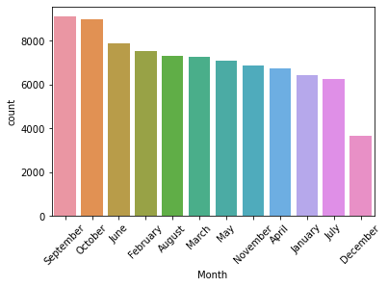
Count of songs released per month:

Slide 7
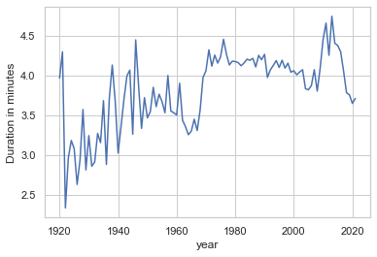
DURATION OF SONG OVER THE YEARS:

Slide 8
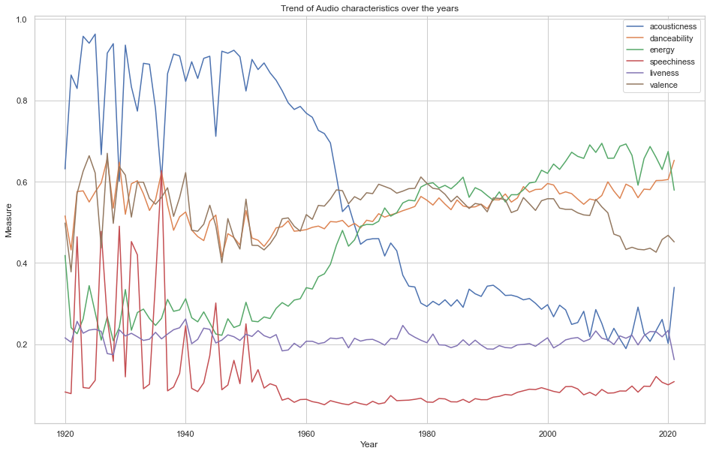
AUDIO CHARACTERISTICS OVER THE YEARS:

Slide 9
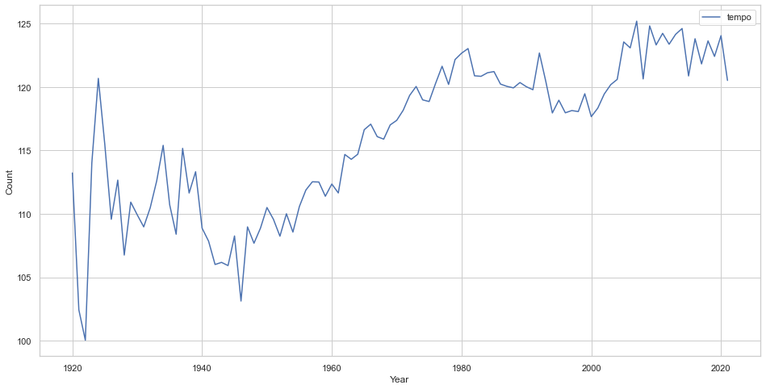
AUDIO CHARACTERISTICS OVER THE YEARS:

Slide 10
K-MEANS CLUSTERING

Slide 11
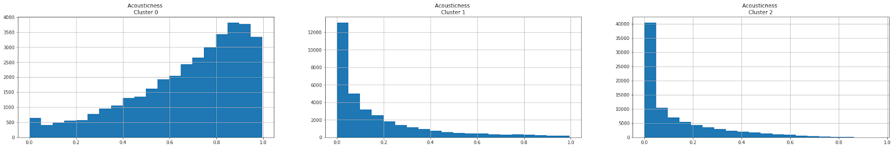
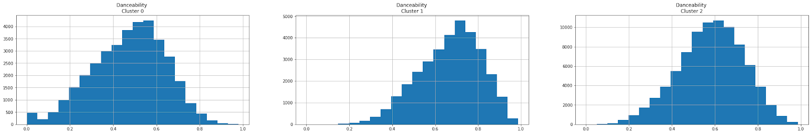
VISUALIZING THE CLUSTERS

Slide 12
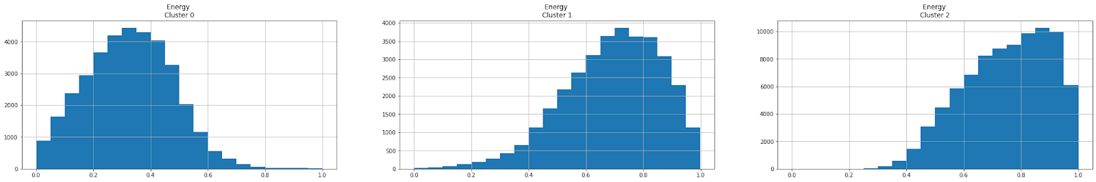
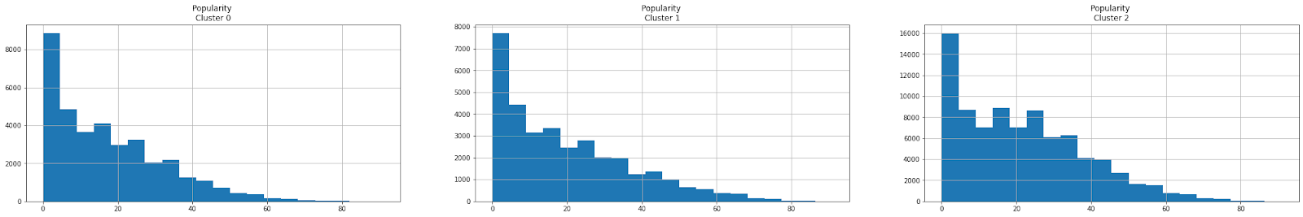
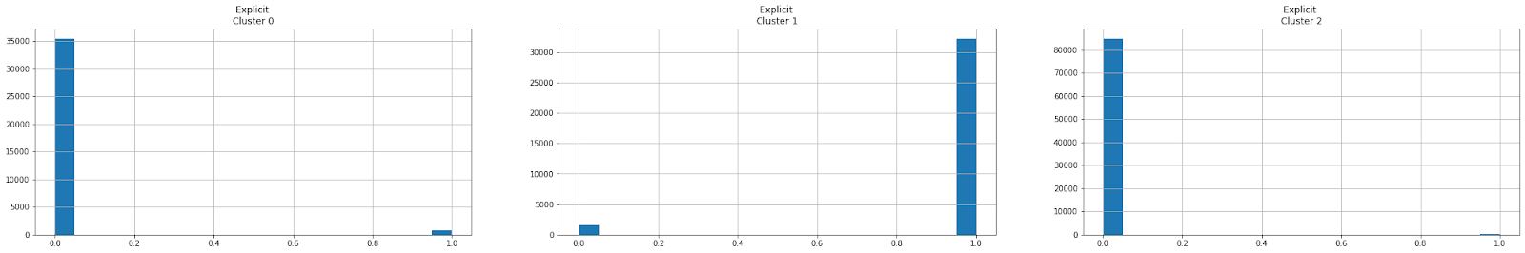
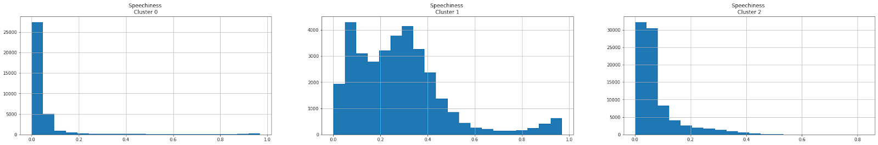
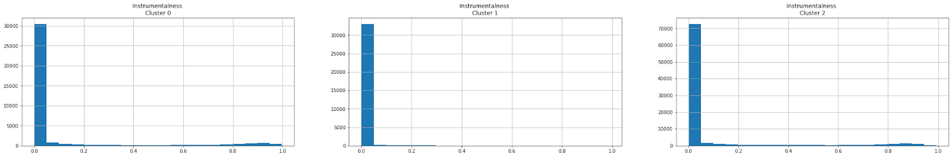
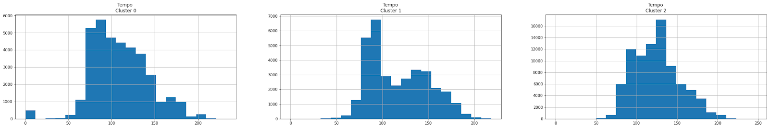
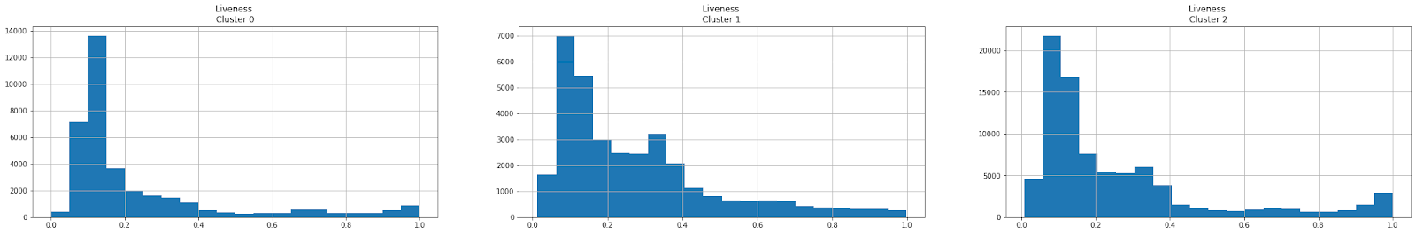
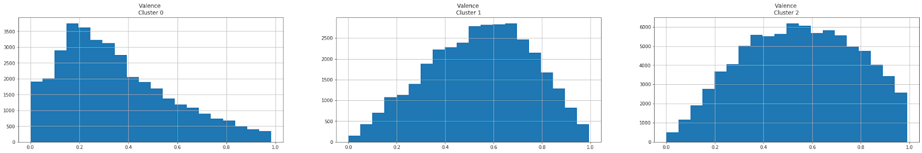
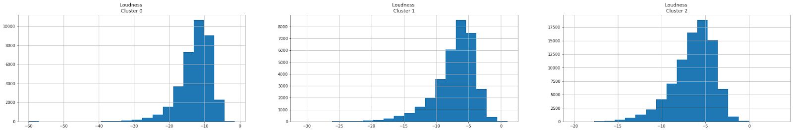
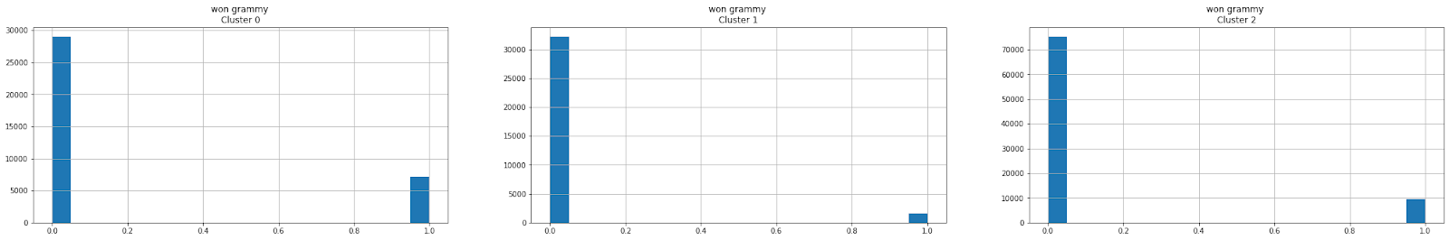
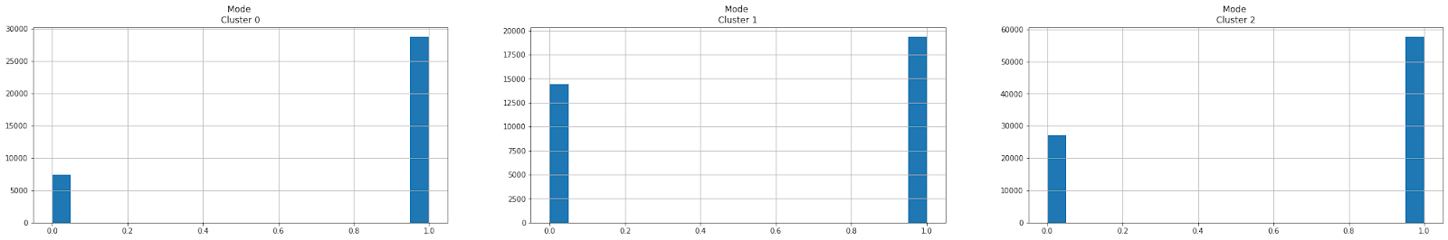
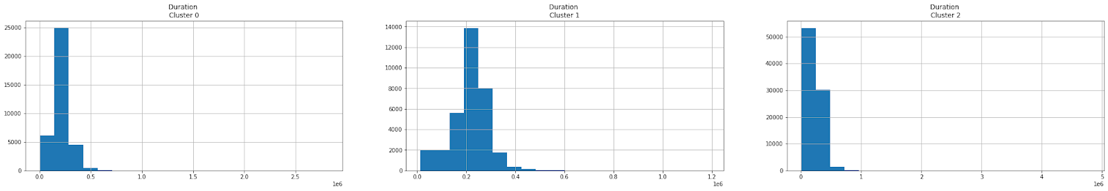

Slide 13
INTERPRETATION OF THE CLUSTERS
Cluster 0:
Highest number of Grammy winning songs.
Less explicit content.
Least number of popular songs.
Highest Acousticness.
Low-medium Energy.
Cluster 1:
Least number of Grammy winning songs.
Most explicit content.
Medium popularity- more than cluster 0
Low Acousticness.
High Energy.
Highest Speechiness.
Cluster 2:
Less Grammy winning songs.
Least explicit content.
Most popularity.
Low Acousticness.
High Energy.

Slide 14
CLASSIFICATION MODELING

Slide 15
GRAMMY CLASSIFICATION
Why winning a Grammy is so important?
Any performer or producer who wins on the music
industry’s biggest night can expect to see at least
55% more in concert ticket sales as compared to
before they won (VOX,2016).
Before winning a Grammy, producers on average
charge $30,000 to $50,000 per track, after wining
a Grammy, $75,000 per track( Marketplace, 2021).

Slide 16
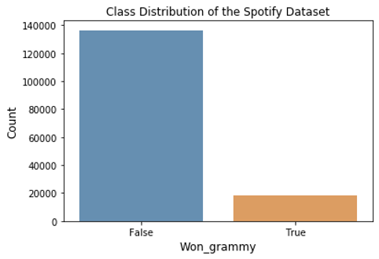
DATA ISSUE
Moderately imbalanced:

Slide 17
MODELS AND METHODOLOGIES
Modeling
Random Forest, Balanced Random Forest, Random Forest + Undersampling+Grid Search hyperparameters, Random Forest + Oversampling, Extreme Gradient Boosting (XGBoost) + Undersampling, XGBoost+ Random Searching hyperparameters as our models. But we chose XGBoost+ Random Searching hyperparameters as the final model because this model gave us the highest f1 score for the minority class.
Methodologies
The methods we use for modeling are Cross Validation, Grid Search hyperparameters, Random Searching hyperparameters, Undersampling, Oversampling, Feature Selection by using models, Feature Importance evaluation.

Slide 18
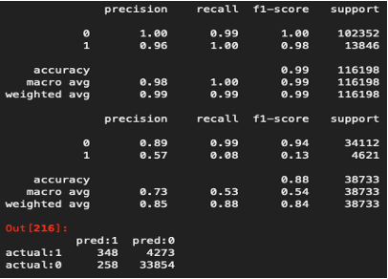
MODEL
Random Forest with
﻿class_weight={0:1,1:7}
Result: Overfitting, Poor prediction on the True class

Slide 19
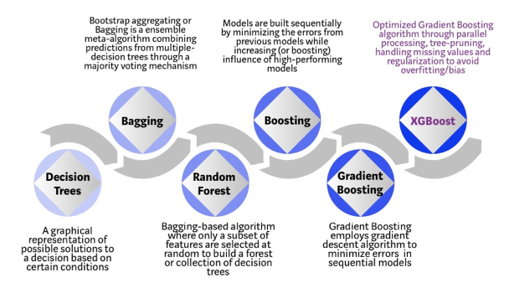
MODEL
Extreme Gradient Boosting (XGBoost) with Random Searching 9 hyperparameters, with a class weight of 7.5 to the True class.

Slide 20
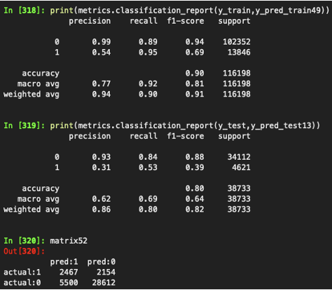
OUTPUTS
1.Not Overfitting
2.F1 score of the True class has improved by 26%

Slide 21
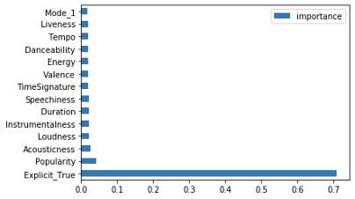
RECOMMENDATION
Avoid curse words or language
or art that is sexual, violent,
or offensive in nature
Open a direction for music
producers to make songs
in the future.

Slide 22
RECOMMENDATION SYSTEM

Slide 23
RECOMMENDATION ALGORITHM
Content based: Uses genre and artists to determine similarity
Example:
Input - “This is America” by Childish Gambino
Output - Songs by Childish Gambino and other songs in the same genre.

Slide 24
Managerial Conclusions & Future Scope
A comprehensive view of the dimensions analyzed in the current project can help producers/distributors within the music industry to make data-centric decisions and engage successfully with target audience on digital platforms.
Improvement to the recommendation engine could be made by also incorporating collaborative filtering of user data. This will provide a good starting point for the content-based engine.
Another layer of recommendation algorithm could be added based on the numerical features in the dataset. The company could also use past user data to develop pre-filtering layers.
The popularity of the songs can be assessed using a more specific subset of attributes and various combinations to enhance the model.

Slide 25
THANKS!!

